Slide 1
CSS and HostGator
CIS2336
Lecture Week 4

Slide 2
Outline
Reminder – Homework Due February 6 midnight
HostGator Account must be checked before class
CSS – Make it look pretty!
Final Project Rubric

Slide 3
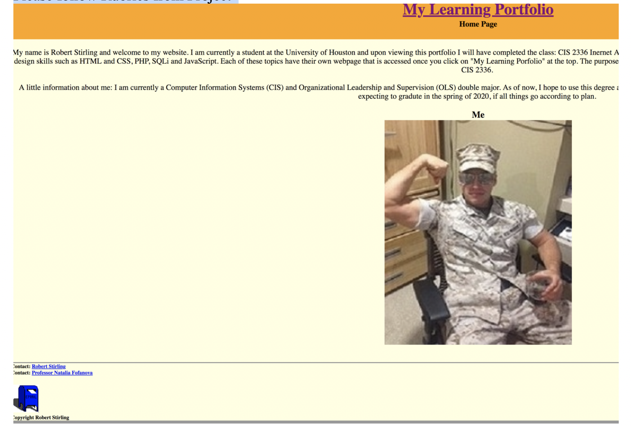
Home Page (index.html)
Lets look at some examples
There is an example of Home Page with link to Learning Portfolio
You can create similar or better.
Please follow Rubrics from Project
Create link to learning Portfolio

Slide 4
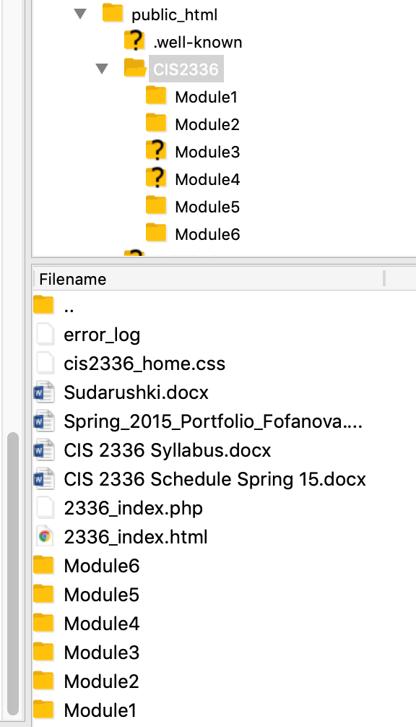
Final project
Now its time to create one by one html_css.html (for HTML and CSS materials), then sql.html (for SQL), java_script.html and so on. Main idea that all pages must be 3 column and liquid (you can do it later)
For now, just create CIS2336 directory and HTM_CSS (Module1); SQL(Module2); and JAVA(Module3) directory in CIS2336
You will have same css for all pages

Slide 5
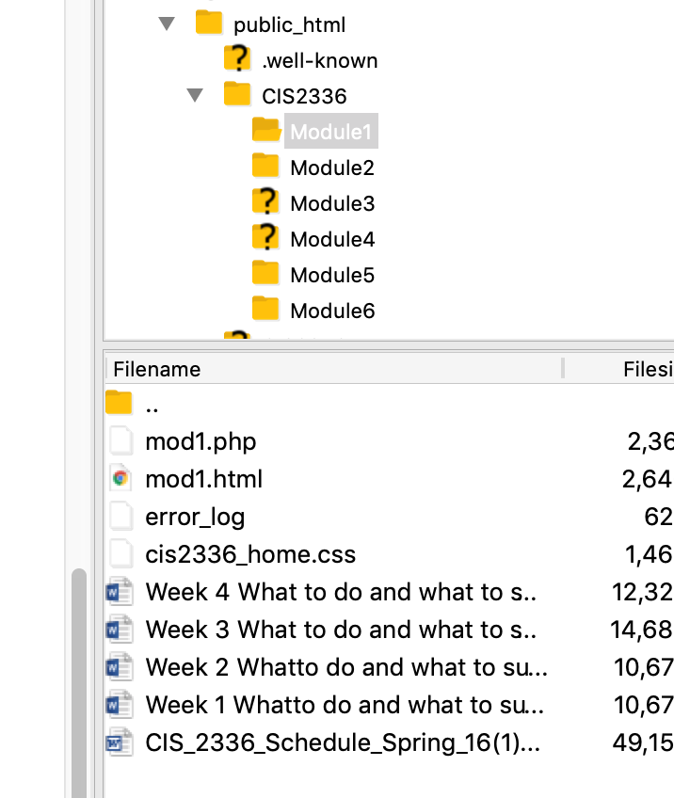
HTML_CSS or Module1 in my case directory
Create html_css.html page with only text: Under construction and transfer under HTML_CSS directory
Transfer the only created css to the same directory
At this point your page is one column and liquid
Your final task to make all pages 3 column and liquid
Notes:
https://www.readyartwork.com/wp-content/uploads/2014/10/responsive_website.jpg
http://3vbiz.com/wp-content/uploads/2015/10/responsive-vs-unresponsive-website.jpg

Slide 6
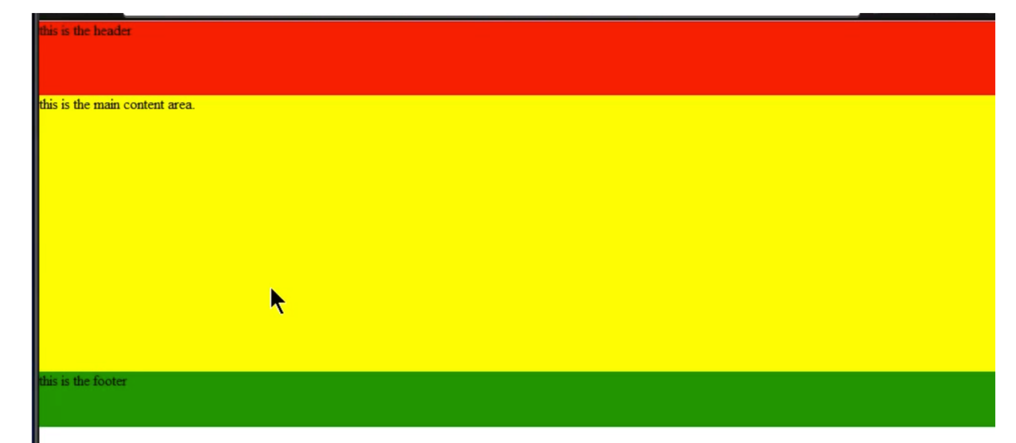
One column liquid web page
Best way to demonstrate that you have truly 1 or 2 or 3 columns page with header and footer if you will use colored blocks like you see.
Please remember – colored block are for exercise and grade reasons. In real Project, we will use digital image design
Notes:
https://www.amarinfotech.com/responsive-vs-adaptive-web-design.html

Slide 7
Lets create together Code for 1 column web page
one_column.html
one_column.html
<!DOCTYPE html>
<html lang=“en”>
<meta charset=“utf-8”>
<title> Liquid Layout with Header and Footer</title>
<link href="./one_column.css" type="text/css" rel="stylesheet">
</head>
<body>
<div id="container">
<header>
this is the header
</header>
<div id="main">
this is my main content area
</div>
<footer>
this is the footer
</footer>
</div>
</body>
</html>

Slide 8
Lets create together Code for 1 column web page
one_column.css
one_column.css
/* css for 1 column colored boxes*/
*{
margin: 0px;
padding: 0px;
}
#cotainer{
width: 990px;
margin: 10px auto;
}
header{
background-color: red;
min-height: 80px;
}
#main{
background-color: white;
min-height: 300px;
overflow: hidden;
}
footer{
background-color: #090;
min-height: 60px;
}

Slide 9
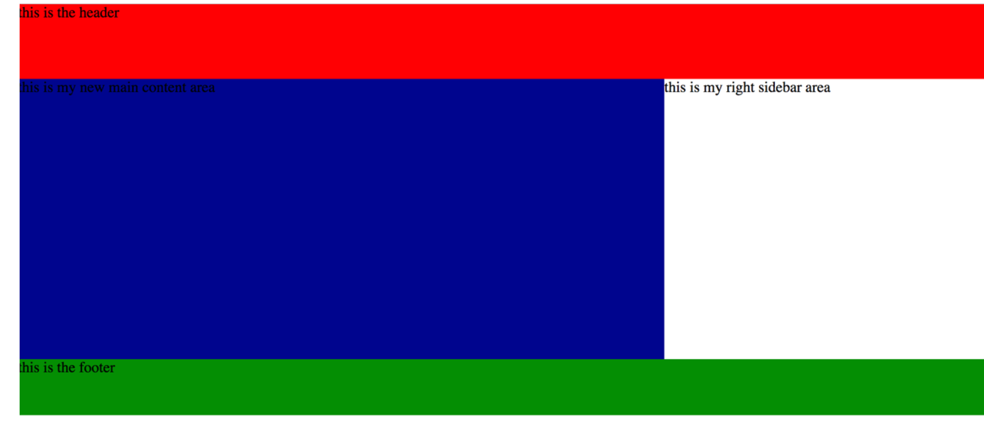
TWO column liquid web page
Best way to demonstrate that you have 2 columns page with header and footer if you will use colored blocks like you see.
Please remember – colored block are for exercise and grade reasons. In real Project, we will use digital image design
Notes:
https://www.amarinfotech.com/responsive-vs-adaptive-web-design.html

Slide 10
DIY
Create 2 column liquid design html with header and footer
Create appropriate css
Transfer to PracticeHTML directory
Make sure to link it to your future Final project for Final grade.

Slide 11
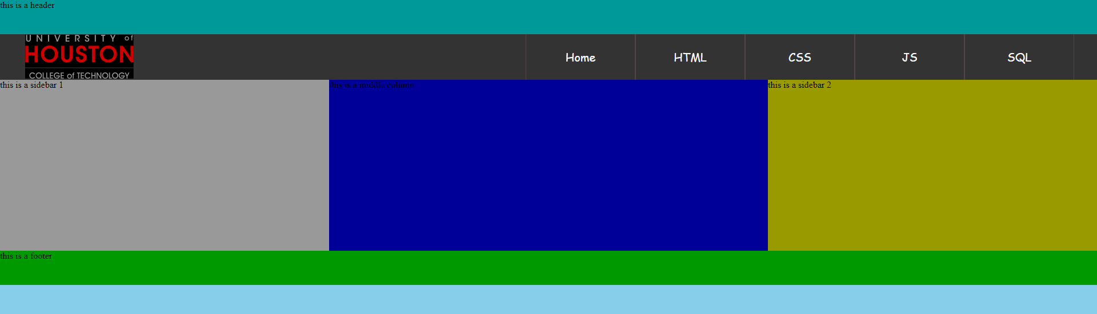
Practical Implementation: Try at home 3 column liquid web page and apply to Final project Try Navigation Bar

